Slide 1

NSG 602: Health Care
Economics, Policy and
Finance
Module Two: Financing and Health Care Reform
Notes:
Good afternoon everyone. Welcome to Module 2 Financing and Health Care Reform. Hopefully, you’ve started, or completed the readings even though we know you’re also wrapping up Module 1.
This session is a supplement to the readings and so to get the most out of this session, you will find it most helpful to come back and listen again after you’ve finished the readings.

Slide 2
Module 2 Objectives
Describe the insurance and system reform provisions outlined in the Patient Protection and Affordable Care Act
Describe the concept of value-based purchasing and its relationship to service delivery reform
Establish the relationship between high-cost health care issues, impact on the current health care system and legislative measures aimed at reform.
Notes:
The objectives for this module are to: Read slide

Slide 3


In the United States
Increased spending is not providing optimal health outcomes
Notes:
As you learned in Module 1, the US spends alot of money on healthcare (upwards of over 20% of the federal budget), yet in spite of this spending we are not seeing optimal health outcomes.

Slide 4
Drivers of Health Care Expenditures in US
Waste
Overconsumption
High prices of inputs & labor
  Defensive medicine (malpractice concerns)
  Fee-for-service rather than fee-for-value
Demographics
  Obesity
  Diverse populations
End-of-life care
Technology Calabrese & Safian 2015
©2009 Rush University Medical Center
Notes:
Now some of the drivers of our expenditures include:
Waste – these are the things that should only be done once or don’t benefit patients such as overtreatment or uncoordinated care
Overconsumption of health care because costs are absorbed elsewhere
High Prices of Inputs and Labor
Malpractice concerns – providers want to protect themselves and do everything to help a patient so over diagnosis, overtreatment and referrals to specialists increase spending
Fee For Service – we are slowly moving to a fee for value system but essentially FFS is still rewarded where fragementation of care and procedures create revenue, versus coordination of care and value based care
Demographics – obesity is a huge cost to the health care system as well as diseases associated with it, and diverse populations are impacted by some diseases disproportionally
End of Life Care – costly with aggressive expensive treatments without improved survival or quality of life
Technology – we are definitely in the technology age and the ability to address illness and disease is growing, but as these technologies continue to advance and emerge we will spend more contributing to the economic burden

Slide 5
Attempts to Control Healthcare Costs
Rationing health care
  Common in other countries
  Not popular in the U.S.
Reducing payments to providers
  Has led to physicians refusing Medicaid patients
Addressing demographic factors
  Public health campaigns & increased tobacco tax
  Wellness programs & obesity initiatives
Calabrese & Safian 2015
©2009 Rush University Medical Center
Notes:
So we’ve identified some contributors/drivers that increase health care costs, but let’s shift and look at some attempts to control costs
Rationing is one example which is common in other countries and has been based on age gender and health, but this is not a popular solution here in the US
Reduced payments –providers will refuse new patients because they are not paid enough
Addressing Demographic Factors – so even with public health campaigns and taxes being implemented there are still individuals who smoke
Similarly, although there are improved outcomes with wellness programs and obesity initiatives only a fraction of covered individuals use programs and obesity rates continue to rise

Slide 6
Reducing Costs & Increasing Value
Medical malpractice reform
Choosing less costly treatments
Pay fixed amounts for procedures
Use electronic medical records
Using value-based purchasing
Reduce costs of end-of-life care
Individual accountability
Calabrese & Safian 2015
©2009 Rush University Medical Center
Notes:
Now some attempts to reduce costs and increase value include
Medical malpractice reform – I mentioned defensive medicine in an earlier slide, so medical malpractice reform would decrease costs
Less expensive, but effective treatment is another
Insurers pay fixed amounts for procedures and patients pay the difference
EMR can reduce duplicate tests and potentially standardize interface
Value Based Purchasing and holding accountable for the cost and quality of care based on performance measures
End of Life Care – change how we spend and increase hospice use
Accountability – this is the personal accountability consumers/patients, WE can take in prevention and doing the things that would decrease cost such as not smoking, exercise, vaccinate etc.

Slide 7
Historical Context That Led to the ACA
  Health insurance coverage in 2012
    170.9 million: employment-based insurance
    50.9 million: Medicaid
    48.9 million: Medicare
    48 million: uninsured
(Kaiser Family Foundation, n.d.)
©2009 Rush University Medical Center
Notes:
Now let’s shift a little bit and think about how we got to the ACA? Well out of our population 170 million were covered by employment based insurance. Then almost 100 million were covered by government provided insurance (Medicaid/Medicare) and the remaining were uninsured. With almost 100 million people covered through government this drove up healthcare costs and placed stress on the budget

Slide 8
Goals of the ACA
1. Establish consumer rights & protections
2. Provide more affordable coverage
3. Ensure better access to care
4. Strengthen Medicare
(Kaiser Family Foundation, n.d.)
©2009 Rush University Medical Center
Notes:
Some of the goals of the ACA were to: Read slide

Slide 9
Basic Provision in the ACA
Insurance coverage
  Medicaid & CHIP expansion
  Subsidies to individuals & businesses
  Individual & employer mandates
  Insurance exchanges
(Kaiser Family Foundation, n.d.)
©2009 Rush University Medical Center
Notes:
Basic provisions in the ACA for insurance coverage are the: Medicaid and Children’s Health Insurance Program (CHIP)
Read slide

Slide 10
Basic Provisions in the ACA
Insurance reform
  Guaranteed issue & pre-existing conditions
  Coverage of dependents
  No life-time limits or rescinding of coverage
  Required benefit categories (bronze, silver, gold)
  Limits to deductibles & waiting periods
  Premium rate reviews
  Transparency & consumer protections
  Health care choice compacts & national plans
  Grandfathering of existing plans
©2009 Rush University Medical Center
Notes:
As you can see from the Appendix in your textbook – there are many provisions in the ACA that aim to increase insurance reform and overall health status of Americans. These included guaranteed issues & pre-existing conditions (such as asthma diabetes HIV cancer)
Read slide

Slide 11
Positive Results of the ACA
  8 to 11 million formerly uninsured gained coverage in 2014 (half in Medicaid)
  Modest contribution to slowing of growth of health care costs
  Expansion of Accountable Care Organizations (Kaiser Family Foundation, n.d.)
©2009 Rush University Medical Center
Notes:
The good news is that there have been positive results of the ACA including

Slide 12
Where is ACA in 115th Congress?
H.R. 1628 – American Health Care Act of 2017
Sponsor – Rep. Diane Black (R-TN)
Called for a vote on May 4, 2017
Passed in U.S. House of Representatives 217-213
https://www.congress.gov/bill/115th-congress/house-bill/1628
©2009 Rush University Medical Center
Notes:
As you know there have been numerous proposals to replace including the midnight or Senate vote in July and last week’s Graham Cassidy Heller Johnson Ammendment. The point here is to stay tuned. Although I’ve briefly highlighted the ACA and provisions, as you have seen this requires constant monitoring – keep educating yourself!

Slide 13
References to Review
The facts on the GOP Health Care Bill http://www.factcheck.org/2017/03/the-facts-on-the-gop-health-care-bill/
Side by Side Comparison: The Affordable Care Act, American Health Care Act and Better Care Reconciliation Act of 2017
https://www.faegrebd.com/the-american-health-care-act-vs-the-affordable-care-act
Kaiser Family Foundation comparison of AHCA and ACA
http://kff.org/interactive/proposals-to-replace-the-affordable-care-act/
©2009 Rush University Medical Center
Notes:
Here are some additional references to review and the second link is a nice side by side comparison of the ACA from a variety of resources to provide a broad view

Slide 14
Value-Based Purchasing
Definition of Value
  “The best patient outcomes relative to the amount of money we as individuals or as a society are able and/or willing to pay to stay healthy or recover from illness.”
Successes in improving value in U.S.
  Lower mortality from stroke, heart disease, cancer
  Longevity after age 75 higher
  Fewer outcome disparities in those on Medicare
Calabrese & Safian 2015
©2009 Rush University Medical Center
Notes:
So earlier we started to touch a bit on value where some of our spending may come down to values, which is not just about the cost or patient outcomes. Instead value focuses on the results and not just the inputs that achieve the results.
Your book has a great definition of value which is: Read slide
We’ve already seen some examples or success in improving value in the US including: Read slide

Slide 15
Value-Based Purchasing
Key elements in VBP
  Measuring and reporting comparative performance standards
  Paying health care providers differently based on performance
  Designing health benefit strategies and incentives to encourage individuals to select high-value services and providers
(NBCH, 2011 & AHRQ, 1997)
©2009 Rush University Medical Center
Notes:
The overarching goal of VBP is a health care system, built on value, with a clear return for every dollar spent.
According to AHRQ, value-based health care purchasing enables buyers to hold providers of health care accountable for both cost and quality of care. Value-based purchasing brings together information on the quality of health care, including patient outcomes and health status. It focuses on managing the use of the health care system to reduce inappropriate care and to identify and reward the best-performing providers.
Key elements of value-based purchasing:
measuring and reporting comparative performance;
paying providers differentially based on performance;
and designing health benefit strategies and incentives to encourage individuals to select high value services and providers and better manage their own health and health care.

Slide 16
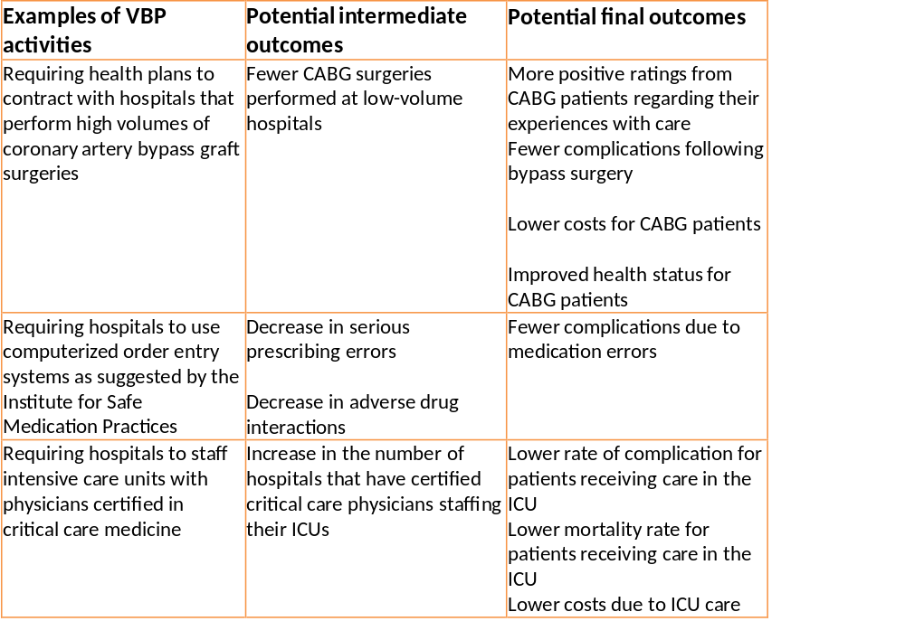
Value-Based Purchasing
(AHRQ, 2002)
©2009 Rush University Medical Center
Notes:
This table is taken directly from the AHRQ website and summarizes VBP activities as well as their potential outcomes.
I won’t go through the entire table but let’s look at the first example activity is to require health plans to contract with hospitals that perform high volumes for CABG surgeries. An immediate outcome would be fewer CABG surgeries will be performed at low-volume hospitals. Which would hopefully result in an increase in overall patient satisfaction, decrease in complications from surgery, lower costs for the patient and health plan and overall improved health status for CABG patients.
The idea is that the requirement will lead to better outcomes and costs savings. So by giving hospitals, providers, or patients a financial incentive to follow the VBP activity, money will be saved, outcomes will improve and the overall efficiency of the health care system will increase.

Slide 17
Module Two “To-Do” List
  Required readings
  Explore the websites included in the Module Two Overview
  Complete power point assignment
  Keep an eye on the discussion board
©2009 Rush University Medical Center
Notes:
Now here is your to do list for this module – hopefully you have already completed the first two items, but we know you are still finishing up Module 1.
You want to complete your power point assignment, which I’ll review in a moment. In addition, I also encourage to keep an eye on the discussion board for questions/answers posted by your peers. Also, per the course announcement, there is a current events thread on the discussion board. Please feel free to add to this discussion frequently throughout the semester.

Slide 18
Composing Your PowerPoint
No more than 8 slides (excluding title & references):
Include:
  Introduction to high-cost legislative issue
  Explanation of significance in health care system (Explain disparities)
  Two proposed, distinct* bills:
    Identifying information
    Description of bill/major provisions
    Sponsor(s) of bill
    Status of bill
    Desired/potential outcomes
*Not companion bills
©2009 Rush University Medical Center
Notes:
Now your module summary does have specific instructions of how to approach the assignment and I hope you take the time to review them, but I’ll provide some highlights here
First, identify a high cost health issue, before you start looking at legislation. You will use this issue and track the legislation over the term.
So ask yourself what you are passionate about? Some examples of potential high cost policy issues include: mental health programs, rural hospital access, and the opioid epidemic. But there may be other issues related to your experience/expertise that are or will be undergoing legislative scrutiny. However, there are two topics that are not acceptable for this course: Nurse Staffing and CRNA Scope of Practice
Next, select legislation that is currently active (from the 115th Congress) or you can focus on current state or local legislation. DO NOT use: Executive orders resolutions, companion bills, or bills signed into law. And just to be clear a companion bill is similar or identical legislation introduced in the Senate and House simultaneously.
The third step is to compose your powerpoint- which should be 8 slides, not including title or references. Your powerpoint presentation should introduce the high cost issue, explain its significance to the health care system, and explain any disparities. You will identify two proposed, distinct bills that relate decreasing cost or improving access. Include the identifying information, description of bill and major provisions, sponsors of the bill, the current status and desired/potential outcomes.
Now before we wrap up and answer any questions I do want to share some reminders on expectations of writing quality. We have provided a variety of resources and the assignment should be clear, organized, without typographical/grammatical errors, and use correct APA formatting, which includes primary sources, as well as reputable online sources.

Slide 19
References
Agency for Healthcare Research and Quality. (1997). Theory and
Reality of Value-Based Purchasing: Lessons from the Pioneer.
Retrieved from http://www.ahrq.gov/professionals/quality-
patient-safety/quality-resources/tools/meyer/
Agency for Healthcare Research and Quality. (2002). Evaluating
the Impact of Value-Based Purchasing. Retrieved from
http://www.ahrq.gov/professionals/quality-patient-
safety/quality- resources/value/valuebased/vbptab2.html
Calabrese, T. & Safian, K.F. (2015). Health care costs and value. In
J.R. Knickman & A. R. Kovner (Eds.). Jonas and
Kovner’s health care delivery in the United States (11th ed.).
(pp. 253 – 270). New York: Springer.
©2009 Rush University Medical Center

Slide 20
References
Kaiser Family Foundation. (n.d.). Health Reform: Frequently
asked questions. Retrieved from http://kff.org/health-reform/faq/health- reform-frequently-asked-questions/
National Business Coalition of Health. (2011). What is value-
based purchasing. Retrieved from http://www.nbch.org/index.asp?bid=529
©2009 Rush University Medical Center

